Slide 1



SUPERSTORE
SQL PROJECT
KATARZYNA TUREK

Slide 2




OVERVIEW
My main goal, when working on this project, was to find a large set of data to work a little bit more on the data normalisation, relationships between the tables and to create codes that would have practical application to larger datasets. To think what kind of business questions might be asked when working on a daily basis.
I finally found “Superstore” dataset on the Kaggle platform.
https://www.kaggle.com/datasets/jazidesigns/sample-superstore/data
The data concerns sales of a wide range of products for equipping office spaces, as well as home offices, for the business and customers sector in the USA.
The database of 10 tables is created to track orders and returns, if any, types of delivery and timeliness, to collect information about consumers, sales results by sector, region or sellers.

Slide 3
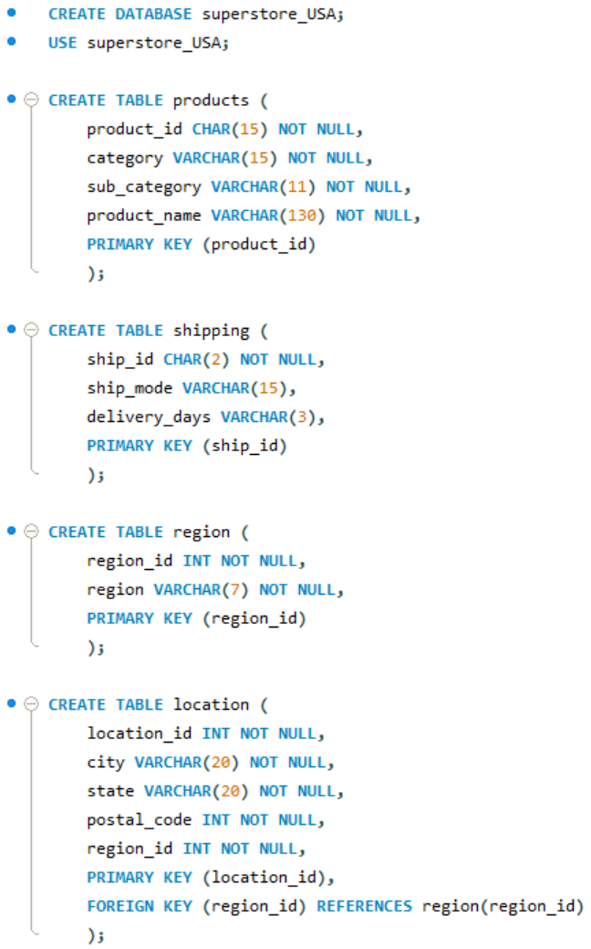
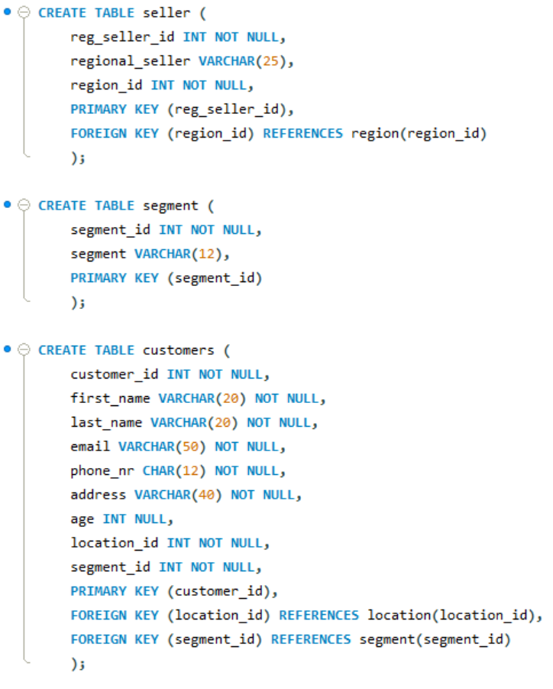
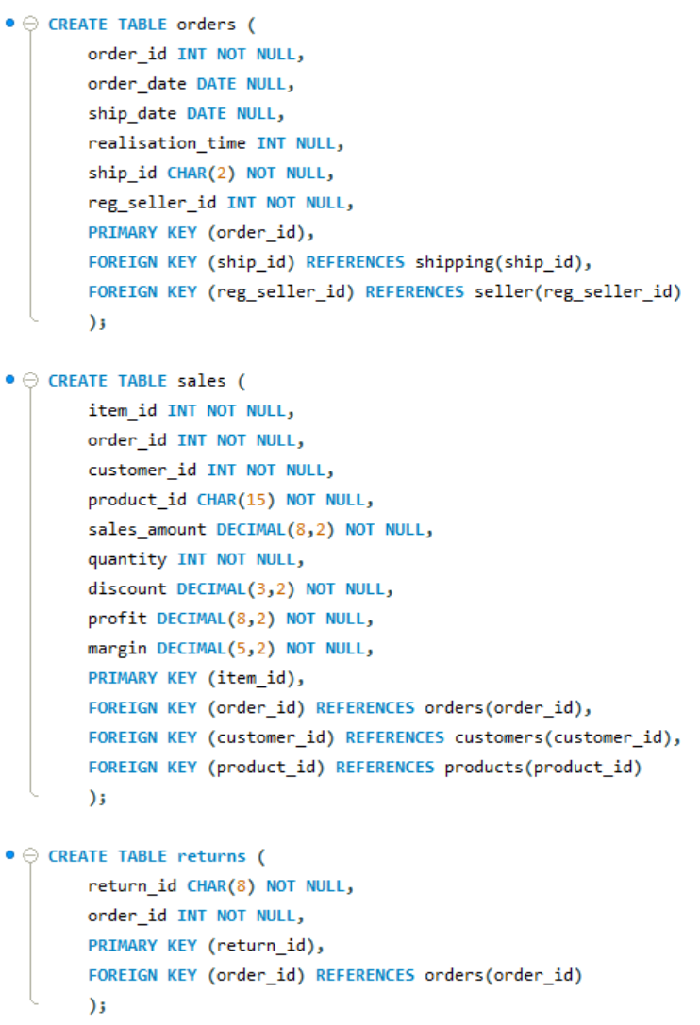
DB CREATION

Slide 4
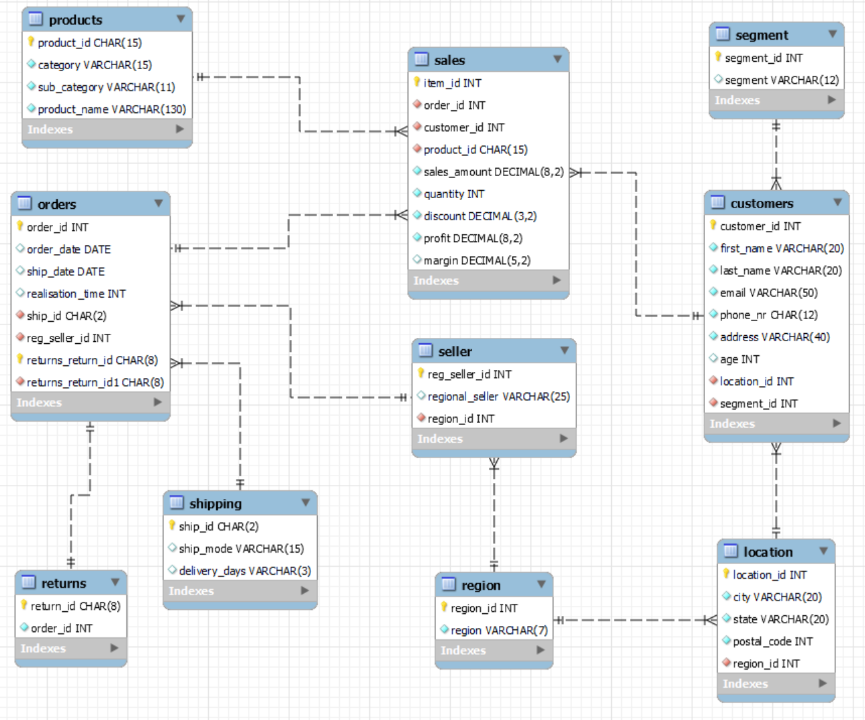
EER DIAGRAM

Slide 5
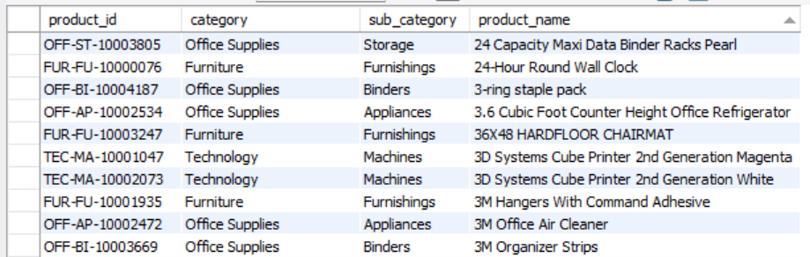

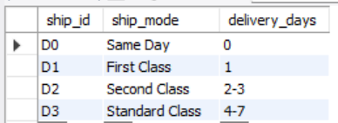
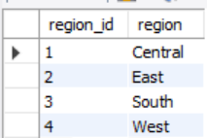
TABLES
1862 ROWS
PRODUCTS
Table contains:
product_id
category
sub_category
product_name
SHIPPING
4 ROWS
Table contains:
ship_id
ship_mode
delivery_days
REGION
4 ROWS
Table contains:
region_id
region

Slide 6
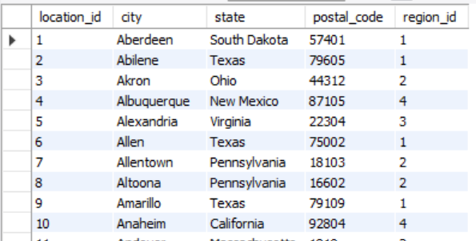
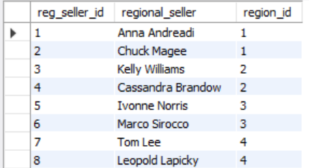
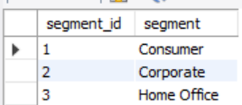
LOCATION
632 ROWS
Table contains:
location_id
city
state
postal_code
region_id
SELLER
8 ROWS
Table contains:
reg_seller_id
regional_seller
region_id
SEGMENT
Table contains:
segment_id
segment
3 ROWS

Slide 7
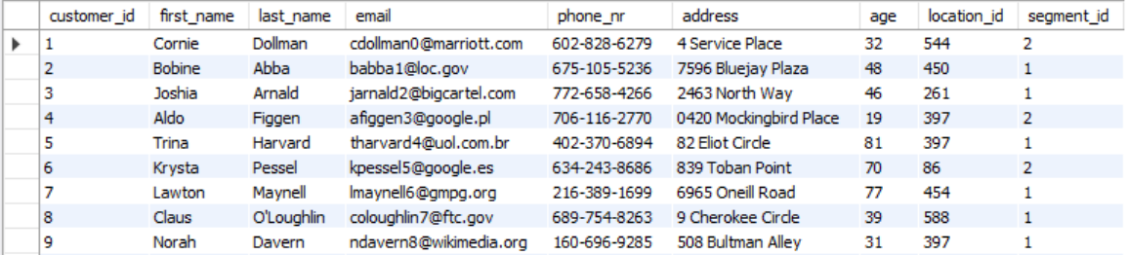
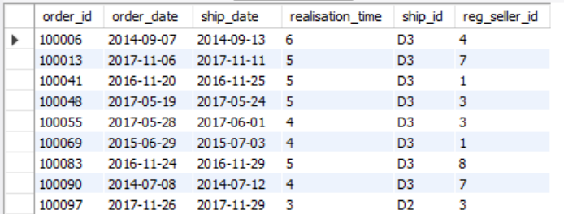
CUSTOMERS
793 ROWS
Table contains:
customer_id
first_name
last_name
email
phone_nr
address
age
location_id
segment_id
5009 ROWS
ORDERS
Table contains:
order_id
order_date
ship_date
realisation_time
ship_id
reg_seller_id

Slide 8
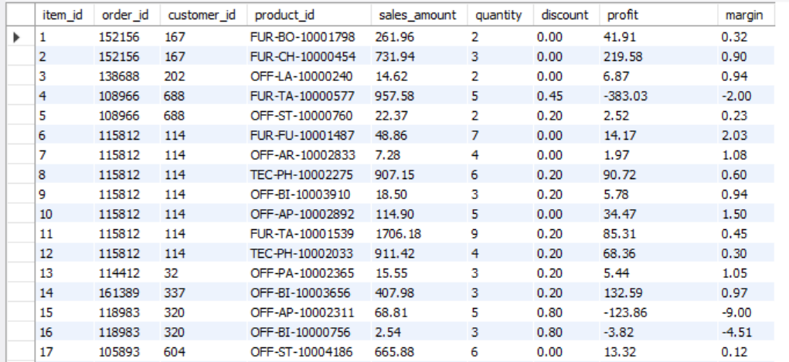
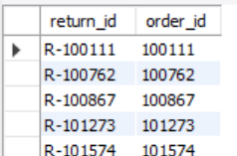
9994 ROWS
SALES
Table contains:
item_id
order_id
customer_id
product_id
sales_amount
quantity
discount
profit
margin
296 ROWS
RETURNS
Table contains:
return_id
order_id

Slide 9


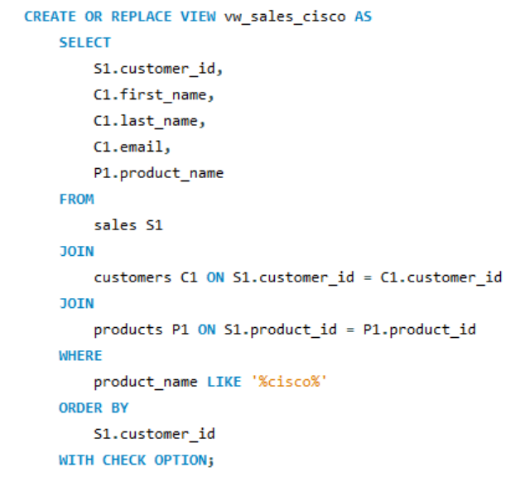

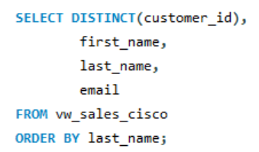
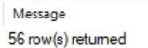
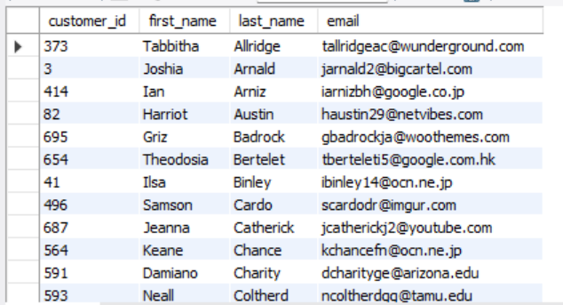
VIEW + JOINS
The Cisco company wants to give a discount to the customers who have already purchased their products at least once.
The below view shows which customer ordered Cisco products, to send them an email with the granting of a discount.

Slide 10
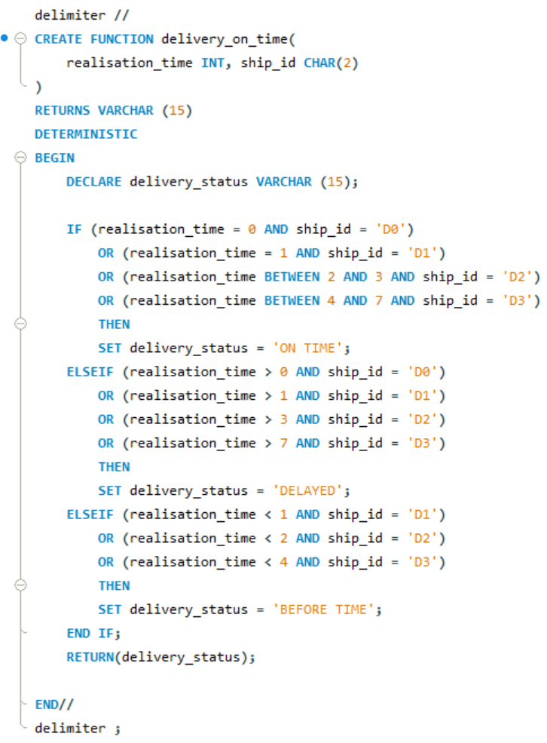
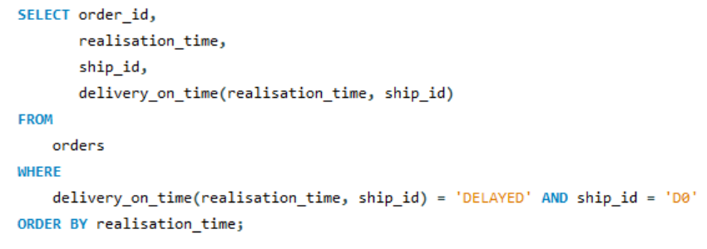
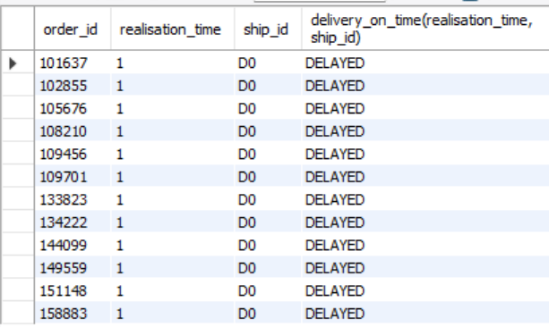

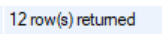
STORED FUNCTION
This function is created to show which orders were delivered before time, on time and which of them were delayed.
'* Below the selection of particular shipping mode, if delayed:

Slide 11
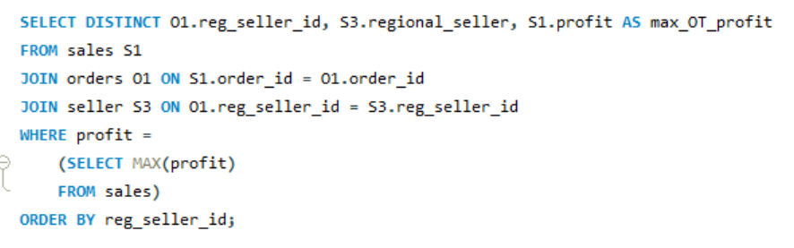

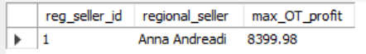
QUERY + SUBQUERY
The Superstore Company wants to know which seller brought the highest one-time profit.
The below query with subquery gives the result.

Slide 12

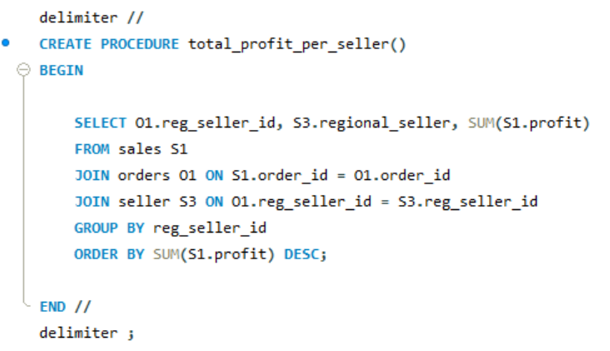
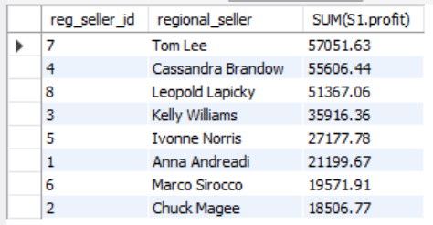
STORED PROCEDURE
The Superstore Company wants to know what is the total profit per each seller.
The below procedure can check it quickly:

Slide 13

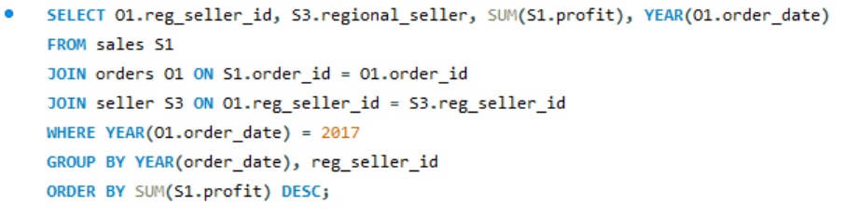
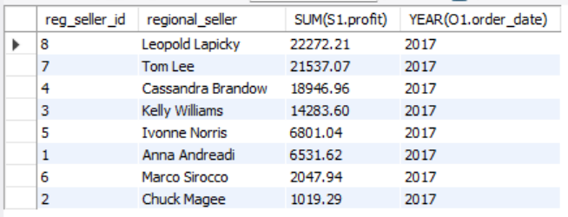
JOIN example
But if we want to know what was the total seller profit in the particular year we can use the below query:

Slide 14
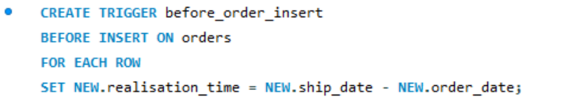

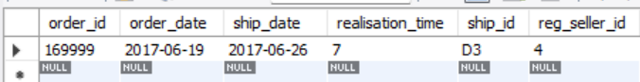
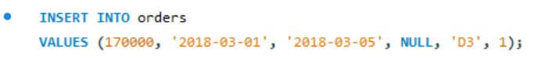
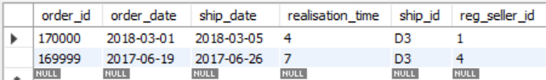
TRIGGER BEFORE INSERT
The below trigger was created to calculate automatically realisation time for new orders.

Slide 15
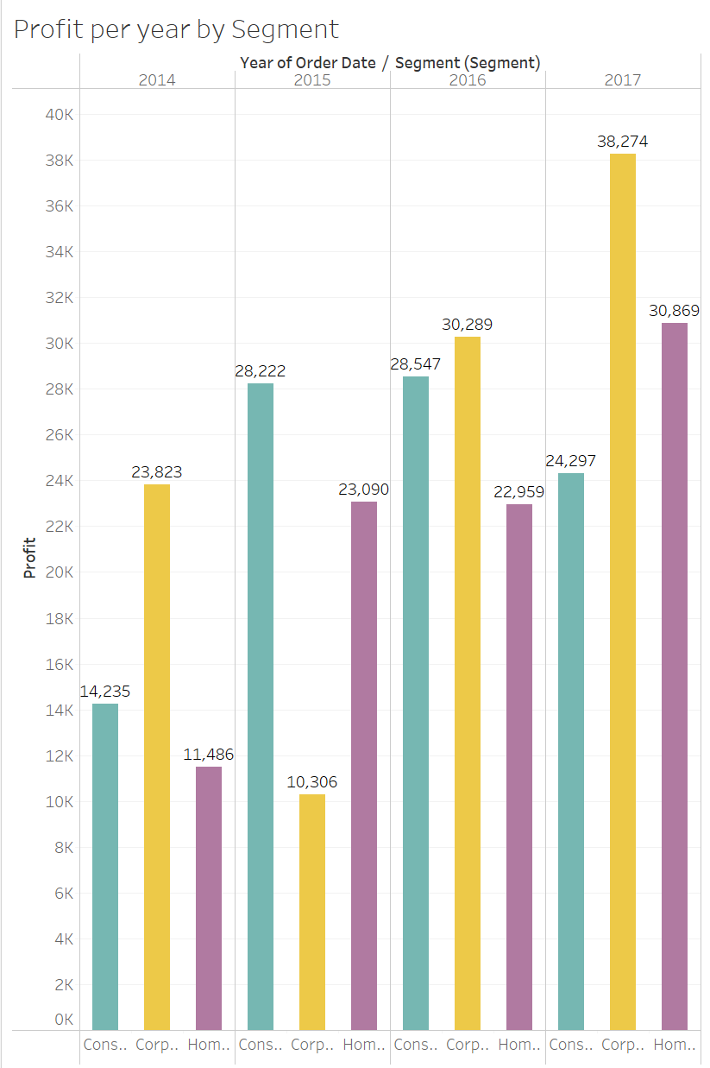
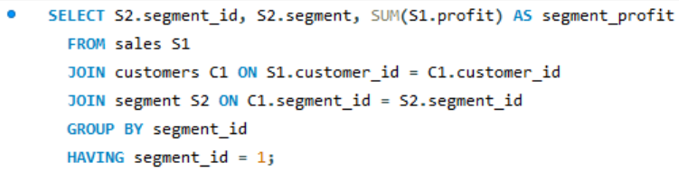
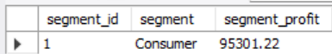
QUERY GROUP BY + HAVING
The below query is showing the total profit earned by the indicated customer segment.
CHECK =>
14235
+ 28222
+ 28547
+ 24297
= 95301
=> TABLEAU VISUALISATIONS IN PROGRESS :)

Slide 16



THANK'S FOR WATCHING
CONTACT DETAILS :
https://www.linkedin.com/in/katarzyna-turek-b25361164/
kt.katarzyna.turek@gmail.com

